Slide 1
Dinner Spinner
Mijeong Ban, Caroline Rubino, Ian Gomez,
Dana McGuire, Luke Bukowiec

Slide 2
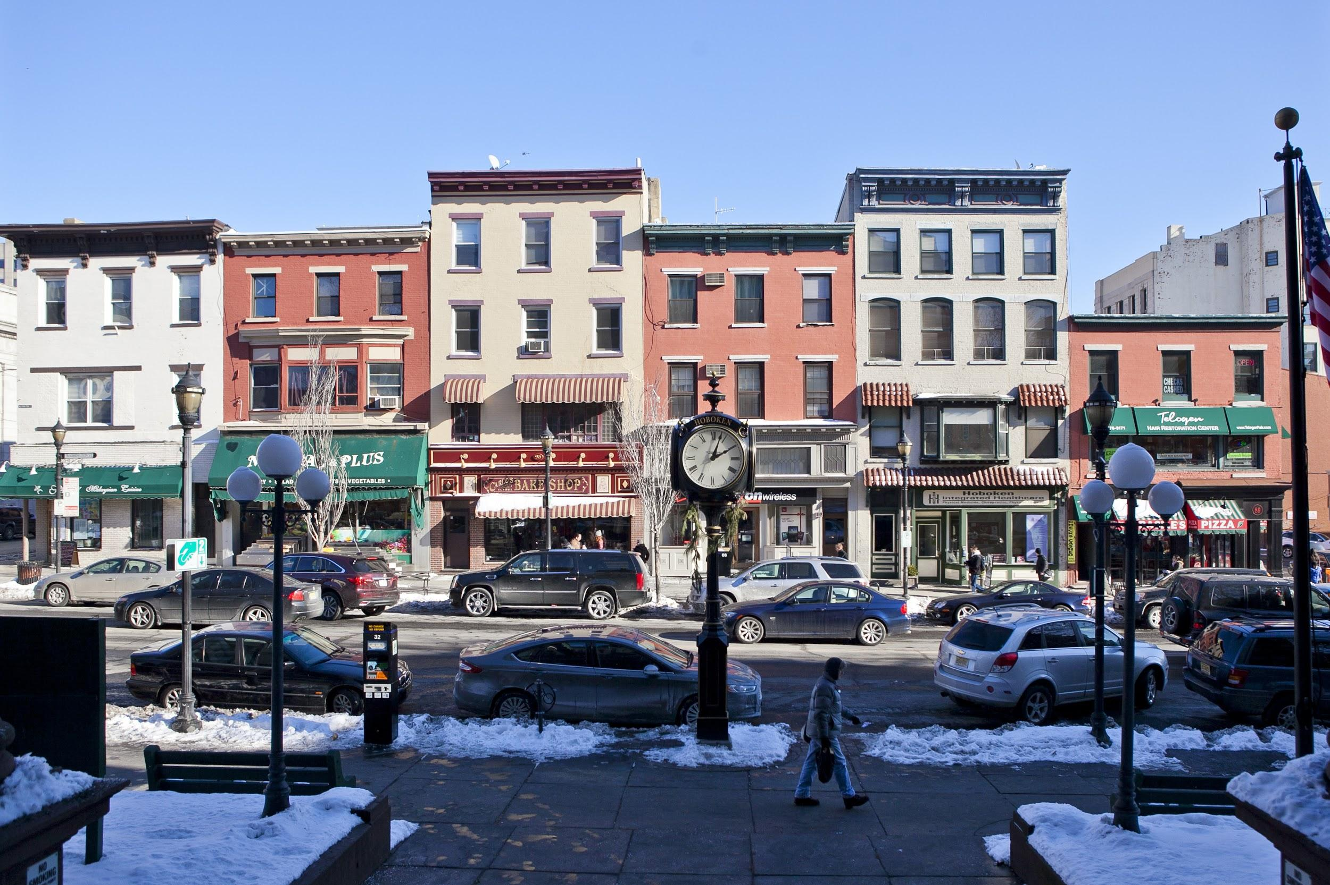
The Problem:
There are tons of restaurants in Hoboken. It can be hard to choose one when there are so many good places to eat.
Many good restaurants exist that some people may have never even heard of.

Slide 3
The Solution: Dinner Spinner
Dinner Spinner is a website that can filter and or randomly select a restaurant in Hoboken near you.
No more wasting time deciding where to eat, just let the Dinner Spinner do all the work.

Slide 4
Features:
The Dinner Spinner website is beautifully designed with an easy to navigate UI.
The website has many features and sections that include:
A startup page (index page)
A restaurant list and map with their locations
A preferences filter
The spinner
A contact us page

Slide 5
Index Page
Responsive Design:
Nav bar
banner
“Get started” button- restaurants
Team Members
“Get In Touch” button - contact in
Footer

Slide 6
Restaurants
Responsive Design:
Drop-down Menu or Map
JS -> connects to new window (restaurant page):
Mouseover (JS) caption
Information
Map - html link

Slide 7
Preference Filter
Used a form to let user choose which types of food they want
Click submit button
List is formed of restaurants that serve the chosen food types

Slide 8
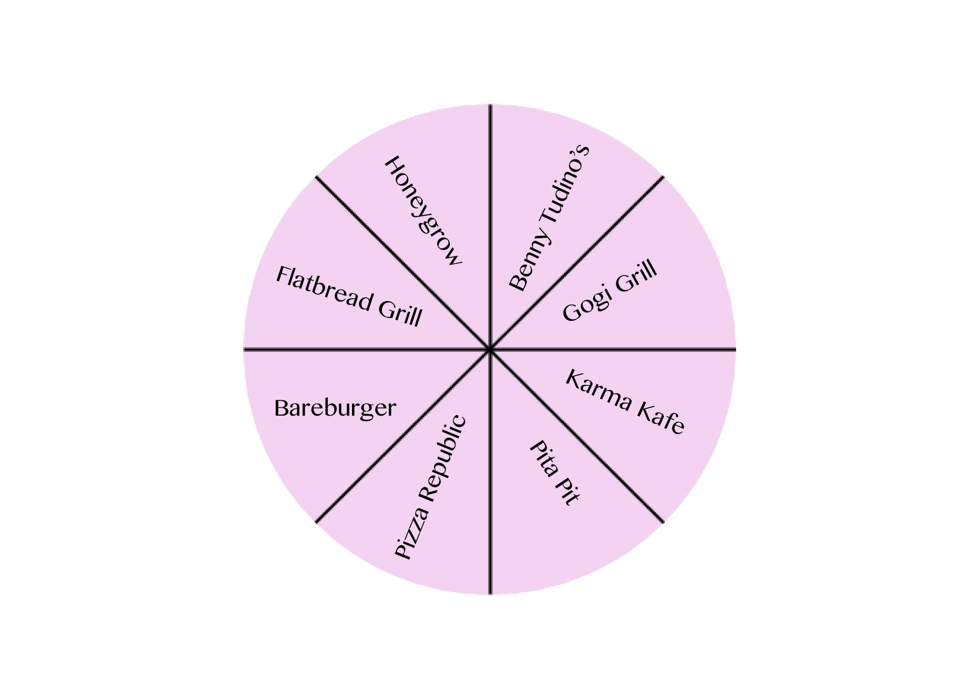
The Spinner
Clicking the “Spin” button initiates the CSS? Code that allows the spinner we made to spin
Once it stops spinning, it redirects you to the restaurant it lands on

Slide 9
Contact us
Takes in the name user types in
Can choose from three rating options
An option to leave a comment for us
Responsive design:
Desktop & Tablet mode- comment is in a box with info on the right side of page
Mobile- comment in box underneath the input section
Notes:
Three different types:
text
Radio
Text area

